Slide 1
WHEN A MACHINE FAILS...
WHO DO YOU ASK?
MACHINE FAILURE
AI ASSISTANT
OR
Senior Technician
AI Assistant
Not Available
Available 24/7
Historical Cases + SOP + Maintenance Knowledge
1 / 6
Notes:
Picture this: a critical machine stops on the floor. Your best technician is on leave. The junior engineer stares at the alarm panel not knowing where to start. This is the maintenance pain point every plant manager knows — expert knowledge disappearing exactly when you need it most. But what if the answer was right there, available at any hour?

Slide 2
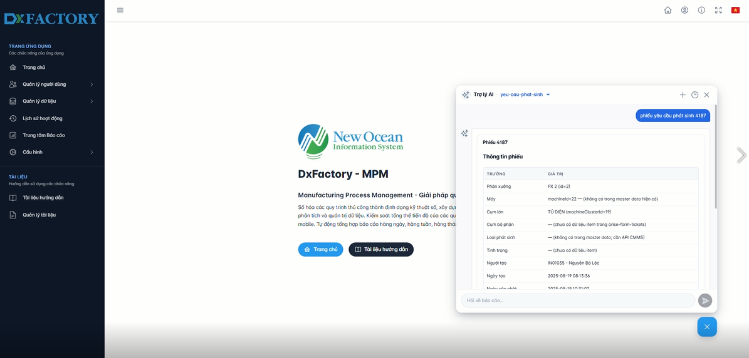
ASK AI
REAL-TIME DIAGNOSIS — INSTANT HISTORICAL CASE SEARCH
Machine vibration
AI searches
6 Similar Cases
Diagnosis
Bearing Wear
and abnormal noise
Found
Root cause identified
Input query
From history
Result
From symptom to root cause — in seconds, not hours
2 / 6
Notes:
Here's the AI assistant in action. A technician types in the symptom — machine vibration and abnormal noise. Within seconds, the system searches through thousands of historical cases and returns a diagnosis: bearing wear, confirmed by six similar incidents in your own maintenance history. No phone calls, no manual search, no guesswork.

Slide 3
FASTER TROUBLESHOOTING
↓
50%
MTTR
Mean Time To Repair — reduced by half
Faster Diagnosis
SOP Guidance
Root Cause Analysis
3 / 6
Notes:
The result is a fifty percent reduction in mean time to repair. Faster diagnosis because the AI knows your machines. Built-in SOP guidance so any technician can follow the right procedure. And root cause analysis that would previously require a senior expert to perform on-site.

Slide 4
EVERY REPAIR MAKES AI SMARTER
AI Assistant
Gets smarter
Ticket
New work order
HOW THE LOOP WORKS
1. Engineer submits a repair ticket
2. AI identifies the root cause
3. Resolution is recorded
4. Knowledge base is updated
Knowledge
5. AI becomes smarter for next time
Base
Continuous
Auto-updated
Learning
The more you use it,
Root Cause
the smarter it gets
AI-identified
Resolution
Repair completed
4 / 6
Notes:
What makes this compound over time is the learning loop. Every ticket closed feeds the knowledge base. Every resolved fault makes the AI smarter for the next one. After six months you have a system that knows your machines. After two years you have institutional memory that outlasts any individual employee.

Slide 5
KNOWLEDGE NEVER LEAVES
Senior Technician
25 years of maintenance expertise
captured & digitized
Knowledge Base
Preserved forever — searchable 24/7
instantly accessible
New Technician
Expert knowledge available from day one
PRESERVE CRITICAL MAINTENANCE KNOWLEDGE
5 / 6
Notes:
This is what we hear most from maintenance managers: when the senior technician retires, his twenty-five years of expertise walks out the door with him. DxFactory captures that expertise digitally — every diagnosis, every fix, every workaround — and makes it instantly available to whoever needs it next, from day one.

Slide 6
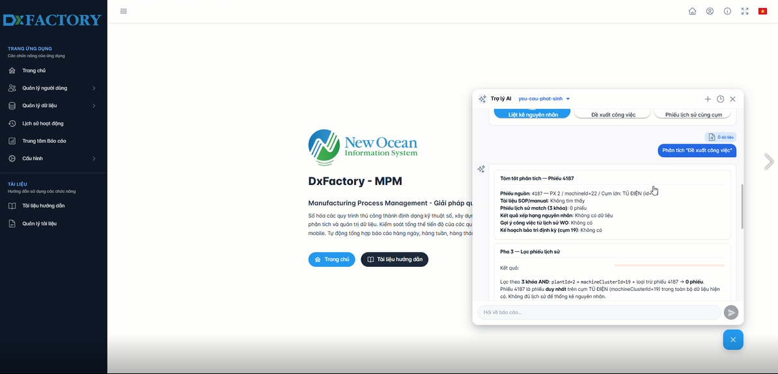
SEE IT LIVE
AI MAINTENANCE
ASSISTANT
VISIT OUR DEMO STATION
Available 24/7 · Auto-learns · Never forgets
6 / 6
Notes:
We have a live demo station right here. Type in any machine fault and watch the AI surface real historical cases and root cause suggestions. Our team is standing by to show you how this integrates with your existing systems. Come try it.

